Slide 1
GPS, MAPS, and CARS
Technology Resource 3: Mr. Arndt

Slide 2
STANDARDS
■3-5.CD.2 Understand the pervasiveness of computers and computing in daily life (e.g., voicemail, downloading videos and audio files, microwave ovens, thermostats, wireless Internet, mobile computing devices, GPS systems).
■3-5.IC.2 Identify the impact of technology (e.g., social networking, cyber bullying, mobile computing and communication, web technologies, cyber security, and virtualization) on personal life and society.
■.3.1 Use labels and symbols to locate and identify physical and political features on maps and/or globes.
■3.3.3 Locate Indiana and other Midwestern states on maps using simple grid systems.

Slide 3
SWBAT
Know how self-driving cars affect our lives
Understand how gps works
Read maps on a grid system
Have a basic understanding of coding

Slide 4

This Photo by Unknown Author is licensed under CC BY-NC-ND

Slide 5
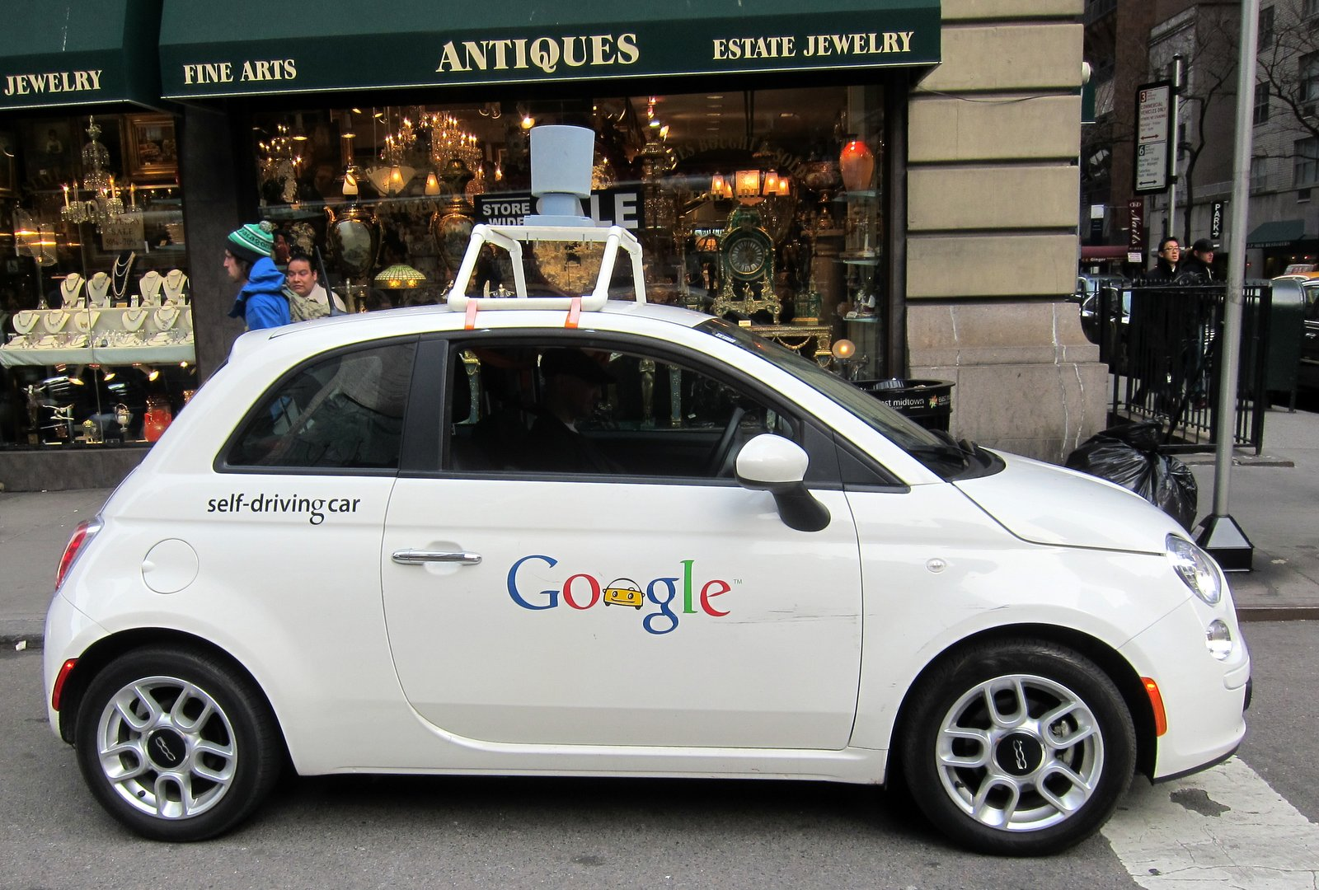
SELF-DRIVING CARS
Cars are being created that can drive themselves.
These cars use sensors, data, and algorithms to create routes that get people from A to B.
This Photo by Unknown Author is licensed under CC BY-NC-ND
Notes:
https://www.iotforall.com/how-do-self-driving-cars-work/

Slide 6
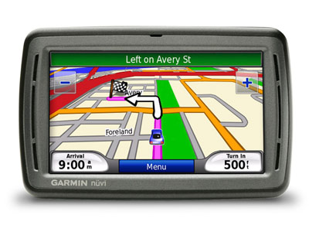
HOW DOES GPS WORK?
GPS Stands for Global Positioning System.
GPS needs multiple satellites to communicate where you are in the world.
GPS uses algorithms to find out how to get to where you want to go in the least amount of time.
This Photo by Unknown Author is licensed under CC BY-NC-ND
Notes:
https://spaceplace.nasa.gov/gps/en/

Slide 7

CODING
Computers use codes to act out what they do.
A code needs a starting event.
This can be anything from a sound or the simple click of a button.
After the starting event the code is acted out.
This Photo by Unknown Author is licensed under CC BY-NC-ND

Slide 8
EXAMPLE CODE
Move Forward Three Steps
Starting Event
Click of Flag
What Happens because of the Starting Event

Slide 9
MAPS AND GRID SYSTEMS
Many Maps Use Grid Systems.
Grid Systems consist of rows and columns
You read a part of the map by row then column
Column
1
Column
2
Row A
Row B

Slide 10
MAPS and GRID SYSTEMS
When reading a map with a grid system you read the row then column.
Where is the Triangle Located?
Where is the Square Located?
Where is the Circle Located?
Column
1
Column
2
Row A
Row B

Slide 11
MAPS, GRID SYSTEMS, and MOVEMENT
How do we use codes and grids to move?
We need to first find the the starting position.
Let’s Start on B,2
Column
1
Column
2
Row A
Row B

Slide 12
MAPS, GRID SYSTEMS, and MOVEMENT
How do we use codes and grids to move?
We need to first find the the starting position.
Let’s Start on B,2
Column
1
Column
2
Row A
Row B

Slide 13
MAPS, GRID SYSTEMS, and MOVEMENT
Let’s get to the Blue Triangle.
Let use a green flag as a starting event.
Then we need to move up and left.
The code looks like this.
Column
1
Column
2
Row A
Row B

Slide 14
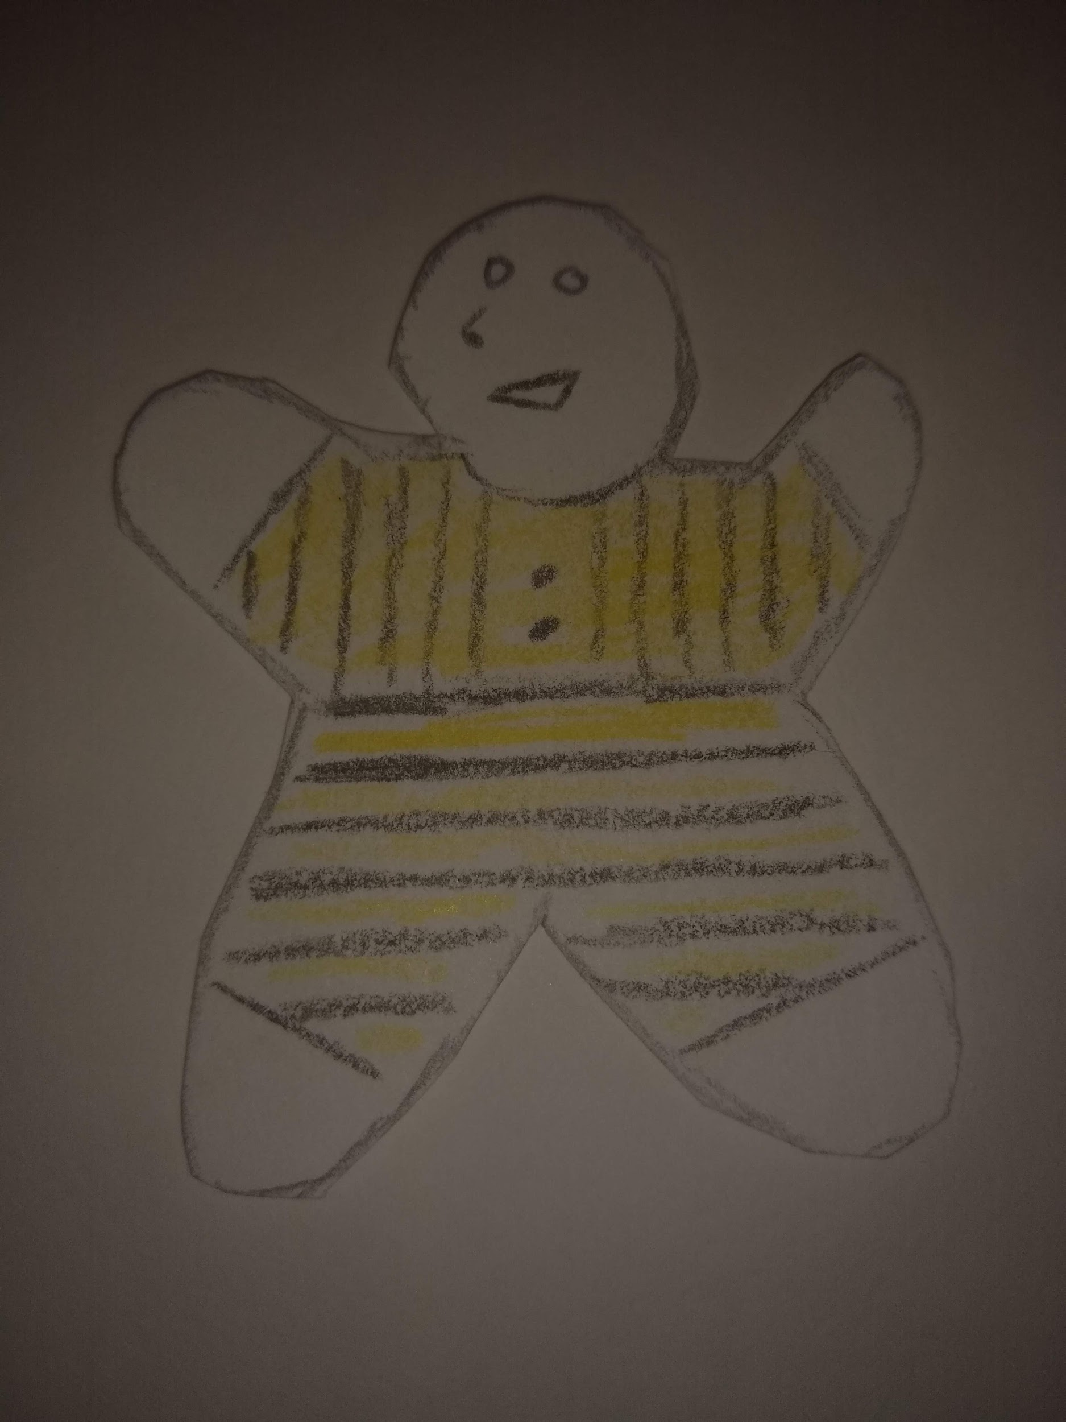
BUDDY’S WORLD
You will be helping Buddy get around today using his self-driving car and gps.
Use the GRID SYSTEM and CODING to move buddy around.
Grab paper and a pen or pencil.
I will split you up into small groups.
We will do one as an example.

Slide 15

Buddy is going from his house to school.
With your small group write a code and answer these questions.
Use a starting event and code to get him there.
Where does he start?
Where does he end?
How does he get there?
Notes:
https://publicdomainvectors.org/en/free-clipart/HB-pencil-vector-image/7528.html Pic Source

Slide 16
Buddy is going from the school to Stacey’s house.
With your small group write a code and answer these questions.
Use a starting event and code to get him there.
Where does he start?
Where does he end?
How does he get there?
Notes:
https://publicdomainvectors.org/en/free-clipart/HB-pencil-vector-image/7528.html PIC Source

Slide 17

Buddy is going from Stacey’s home to the Library.
He has to pick up Luis at his house before going to the Library
With your small group write a code and answer these questions.
Use a starting event and code to get him there.
Where does he start?
Where does he end?
How does he get there?
Notes:
https://freesvg.org/black-and-white-open-book-vector-clip-art PIC SOURCE

Slide 18

Buddy and Luis are going to the store for food from the Library and will be dropping it off at the Old Folks home.
With your small group write a code and answer these questions.
Use a starting event and code to get him there.
Where does he start?
Where does he end?
How does he get there?
Notes:
https://freesvg.org/black-and-white-open-book-vector-clip-art
https://publicdomainvectors.org/en/free-clipart/Bread-clip-art/83296.html

Slide 19

After a long day Buddy goes to the park from the Old Folks home and then goes to his home to go to bed.
With your small group write a code and answer these questions.
Use a starting event and code to get him there.
Where does he start?
Where does he end?
How does he get there?
Notes:
https://www.goodfreephotos.com/vector-images/cartoon-conifer-tree-pine-tree-drawing-vector-clipart.png.php

Slide 20
Let’s Reflect
What did you learn today?
How do self-driving Cars affect our life?
How do self-driving Cars use GPS?
How did you go about getting Buddy from point A to B?

