Slide 1
Identifying Accurate Sources
Technology Resource #2 W200
Thomas Arndt

Slide 2
Table of Contents
First Slide
Fake News
Research Using the CRAAP Model
Fake News Activity
Source Reliability Activity
Final Questions

Slide 3
Standard
ISTE 3a
Students plan and employ effective research strategies to locate information and other resources for their intellectual or creative pursuits.
ISTE 3b
Students evaluate the accuracy, perspective, credibility and relevance of information, media, data or other resources.

Slide 4
Fake News

Slide 5
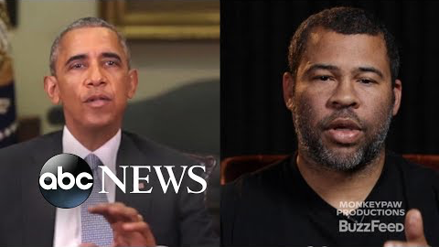
Deepfakes
Notes:
Source: https://www.youtube.com/watch?v=bE1KWpoX9Hk

Slide 6
Some Questions to Consider
Why in the 21st century is it important to be able to discerned fake news from real news?
In what ways have you been affected by fake news?
Is it becoming more difficult to identify fake news?
How should we go about increasing our media literacy?
How do we identify and evaluate the reliability of soures?

Slide 7
Media Literacy
Media Literacy is, “the ability to access, analyze, evaluate, create, and act using all forms of communication.”
Simply it is the ability to critically think and create bases of information.
It is important to have media literacy because new forms of technology and ways to access information are becoming more prevalent in our daily life.
It also important to be able to critically identify the level of reliability when researching and interpreting information.
Notes:
Source: https://namle.net/publications/media-literacy-definitions/

Slide 8
Types of Fake News
Deliberate Misinformation
News written for profit and used on social media
False Headlines
When a headline states as true and the article is not true
Can also be known as clickbait
Social Media Sharing
Social Websites that use news without verifying relying on quick positive feedback
Satire
News that’s primarily used for comedy, parody, or for satirical comment on society.

Slide 9
Research Using
The CRAAP Model
Notes:
https://www.prattlibrary.org/research/tools/index.aspx?cat=90&id=473 5 Photo Source

Slide 10
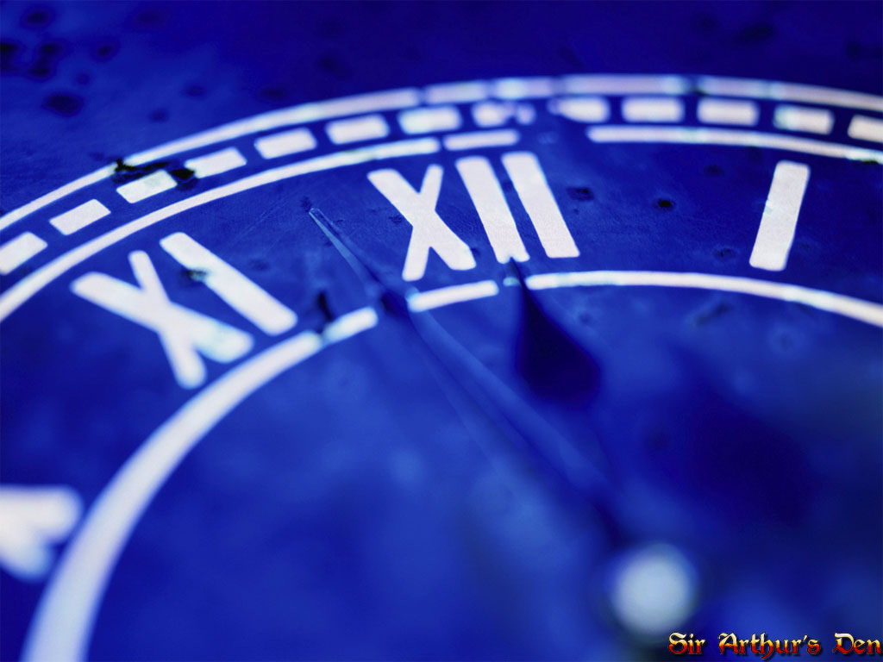
Currency
“The timeliness of the information.”
Good Sources…
  Are recent or time relevant
  Have been revised recently
  Have up to date information
This Photo by Unknown Author is licensed under CC BY-SA-NC
Notes:
Source: https://researchguides.ben.edu/source-evaluation

Slide 11

Relevance
“The importance of the information for your needs.”
Good Sources
  Are relevant to the topic
  Are at a specific reading level
  Are used in a variety of other sources
This Photo by Unknown Author is licensed under CC BY-NC
Notes:
https://researchguides.ben.edu/source-evaluation

Slide 12
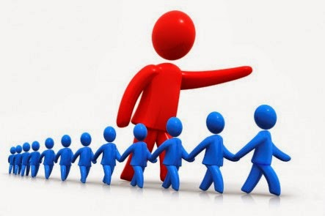
Authority
The source of the information
Good Sources
  Have an author with credentials
  Have an author with good qualifications
  Have contact information from the author or sponsored website
  Have a reliable url label
    .com (commercial), .edu, (education), .gov (government), .org (nonprofit organization), and .net (network).
This Photo by Unknown Author is licensed under CC BY-NC-ND
Notes:
https://researchguides.ben.edu/source-evaluation

Slide 13
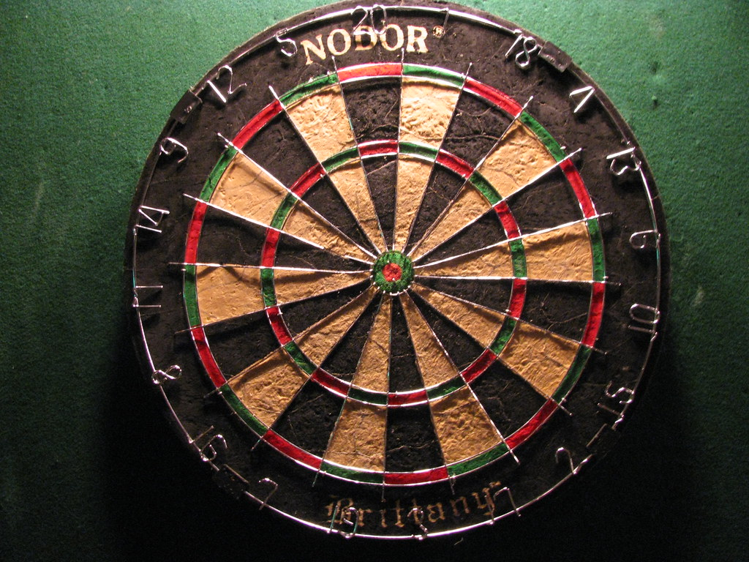
Accuracy
“The reliability, truthfulness, and correctness of content.”
Good Sources
  Come from a reliable source
  Have information supported by evidence
  Have easily verifiable information
  Are unbiased
  Have little to no grammar or spelling errors
This Photo by Unknown Author is licensed under CC BY-SA-NC
Notes:
https://researchguides.ben.edu/source-evaluation

Slide 14

Purpose
”The reason the information exist”
Good Sources
  Have a specific purpose
    To Inform, To Persuade, To Entertain
  Have a clear objective stated
This Photo by Unknown Author is licensed under CC BY-SA
Notes:
https://researchguides.ben.edu/source-evaluation

Slide 15
Fake News Activity
You will be prompted a picture. Click the picture and review the source, say whether it is fake or not.

Slide 16
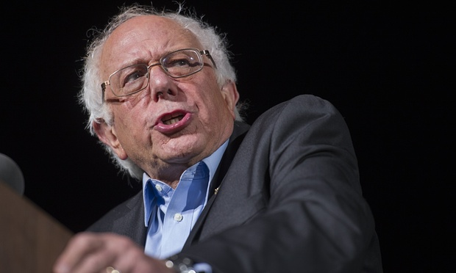
This Photo by Unknown Author is licensed under CC BY-NC-ND
Real
Fake
Notes:
Source: https://politics.theonion.com/bernie-sanders-renounces-call-for-economic-equality-aft-1839078863

Slide 17
Correct
This is fake news because it is satirical.
Websites like the onion, while humorous, use fake news for entertainment.
Question 2

Slide 18
Incorrect
This is fake news because it is satirical.
Remember fake news can be used for entertainment like how the onion used this article for entertainment.
Question 2

Slide 19
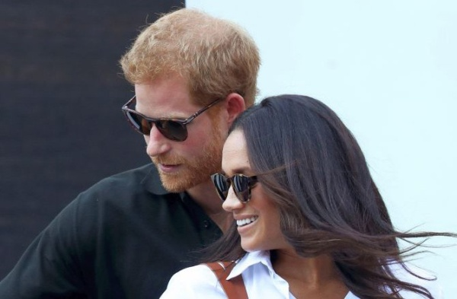
This Photo by Unknown Author is licensed under CC BY-SA-NC
Real
Fake
Notes:
https://www.nagpurtoday.in/donate-to-this-mumbai-charity-as-wedding-gift-to-prince-harry-meghan-markle/04092051

Slide 20
Correct
This article is fake because it relies on a misleading headline.
Sources like National Enquire rely heavily on this to bring in views through clickbait.
Question 3

Slide 21
Incorrect
This article is fake because it relies on a misleading headline.
Sources like National Enquire rely heavily on this to bring in views through clickbait.
Question 3

Slide 22

This Photo by Unknown Author is licensed under CC BY-SA
Real
Fake
Notes:
https://www.npr.org/sections/health-shots/2019/10/24/773095904/u-s-travel-ban-disrupts-the-worlds-largest-brain-science-meeting

Slide 23
Correct
This source is real because it does not rely on tactics used for fake news.
Question 4

Slide 24
Incorrect
This source is real because it does not rely on tactics used for fake news.
Question 4

Slide 25
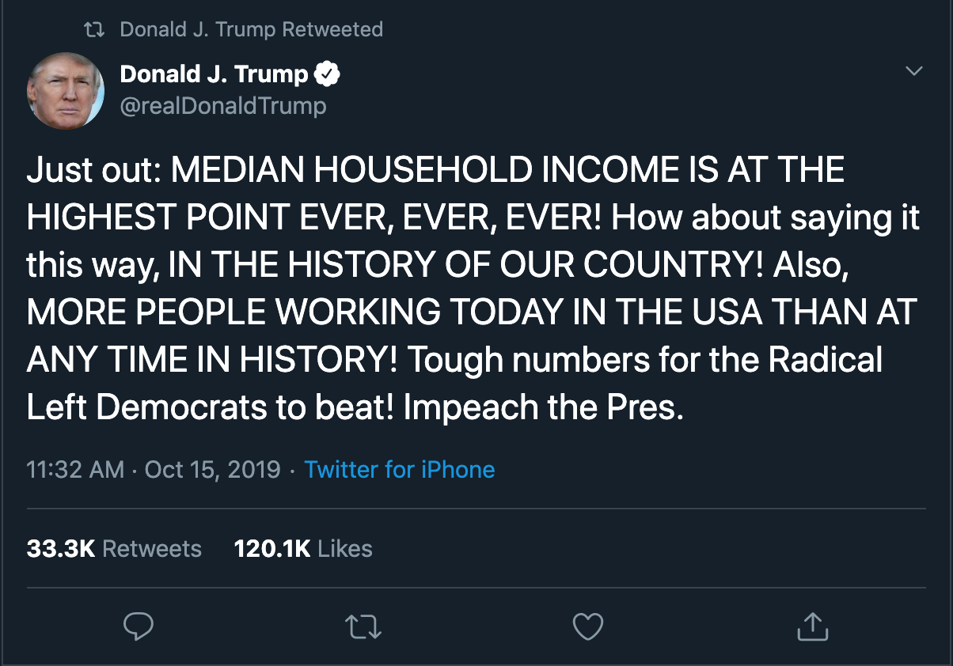
Real
Fake
Notes:
Source: https://twitter.com/realDonaldTrump/status/1184129825231069184

Slide 26
Correct
Social media post can be fake news because of the rapid and untrue information that occurs from social media.
They rely on fake news to receive likes, shares, and comments.
Question 5

Slide 27
Incorrect
Social media post can be fake news because of the rapid and untrue information that occurs from social media.
They rely on fake news to receive likes, shares, and comments.
Question 5

Slide 28
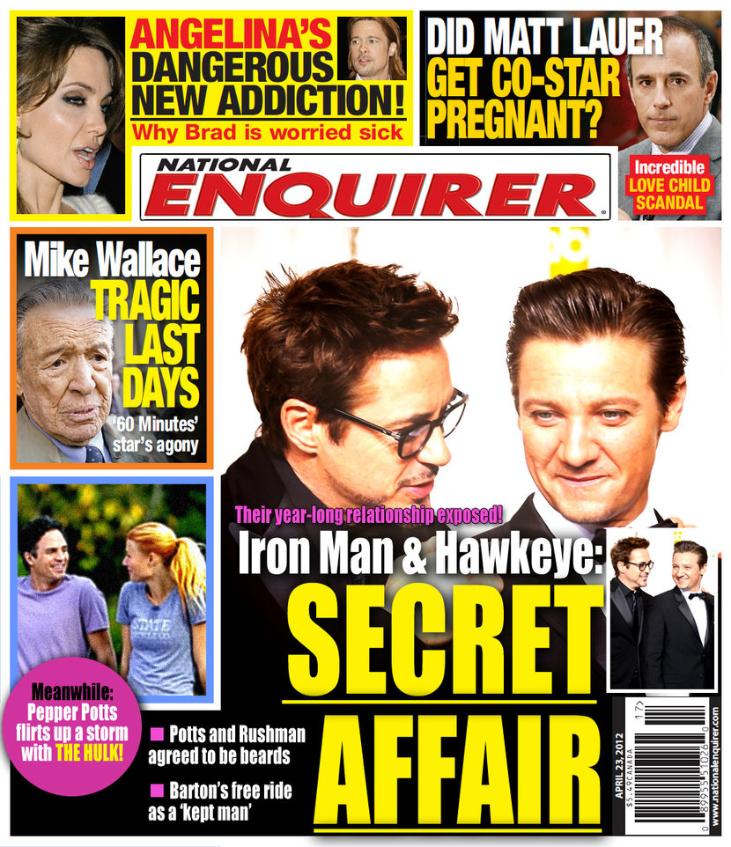
This Photo by Unknown Author is licensed under CC BY-NC-ND
Real
Fake

Slide 29
Correct
This is fake because it creates fake news for profit.
Newspapers like National Enquirer rely on fake news to entertain and create a profit.
2nd Activity

Slide 30
Incorrect
This is fake because it creates fake news for profit.
Newspapers like National Enquirer rely on fake news to entertain and create a profit.
2nd Activity

Slide 31
Source Reliability Activity
You are doing a research paper on ducks. Click the Images to view the source. Say whether it is reliable or unreliable.

Slide 32
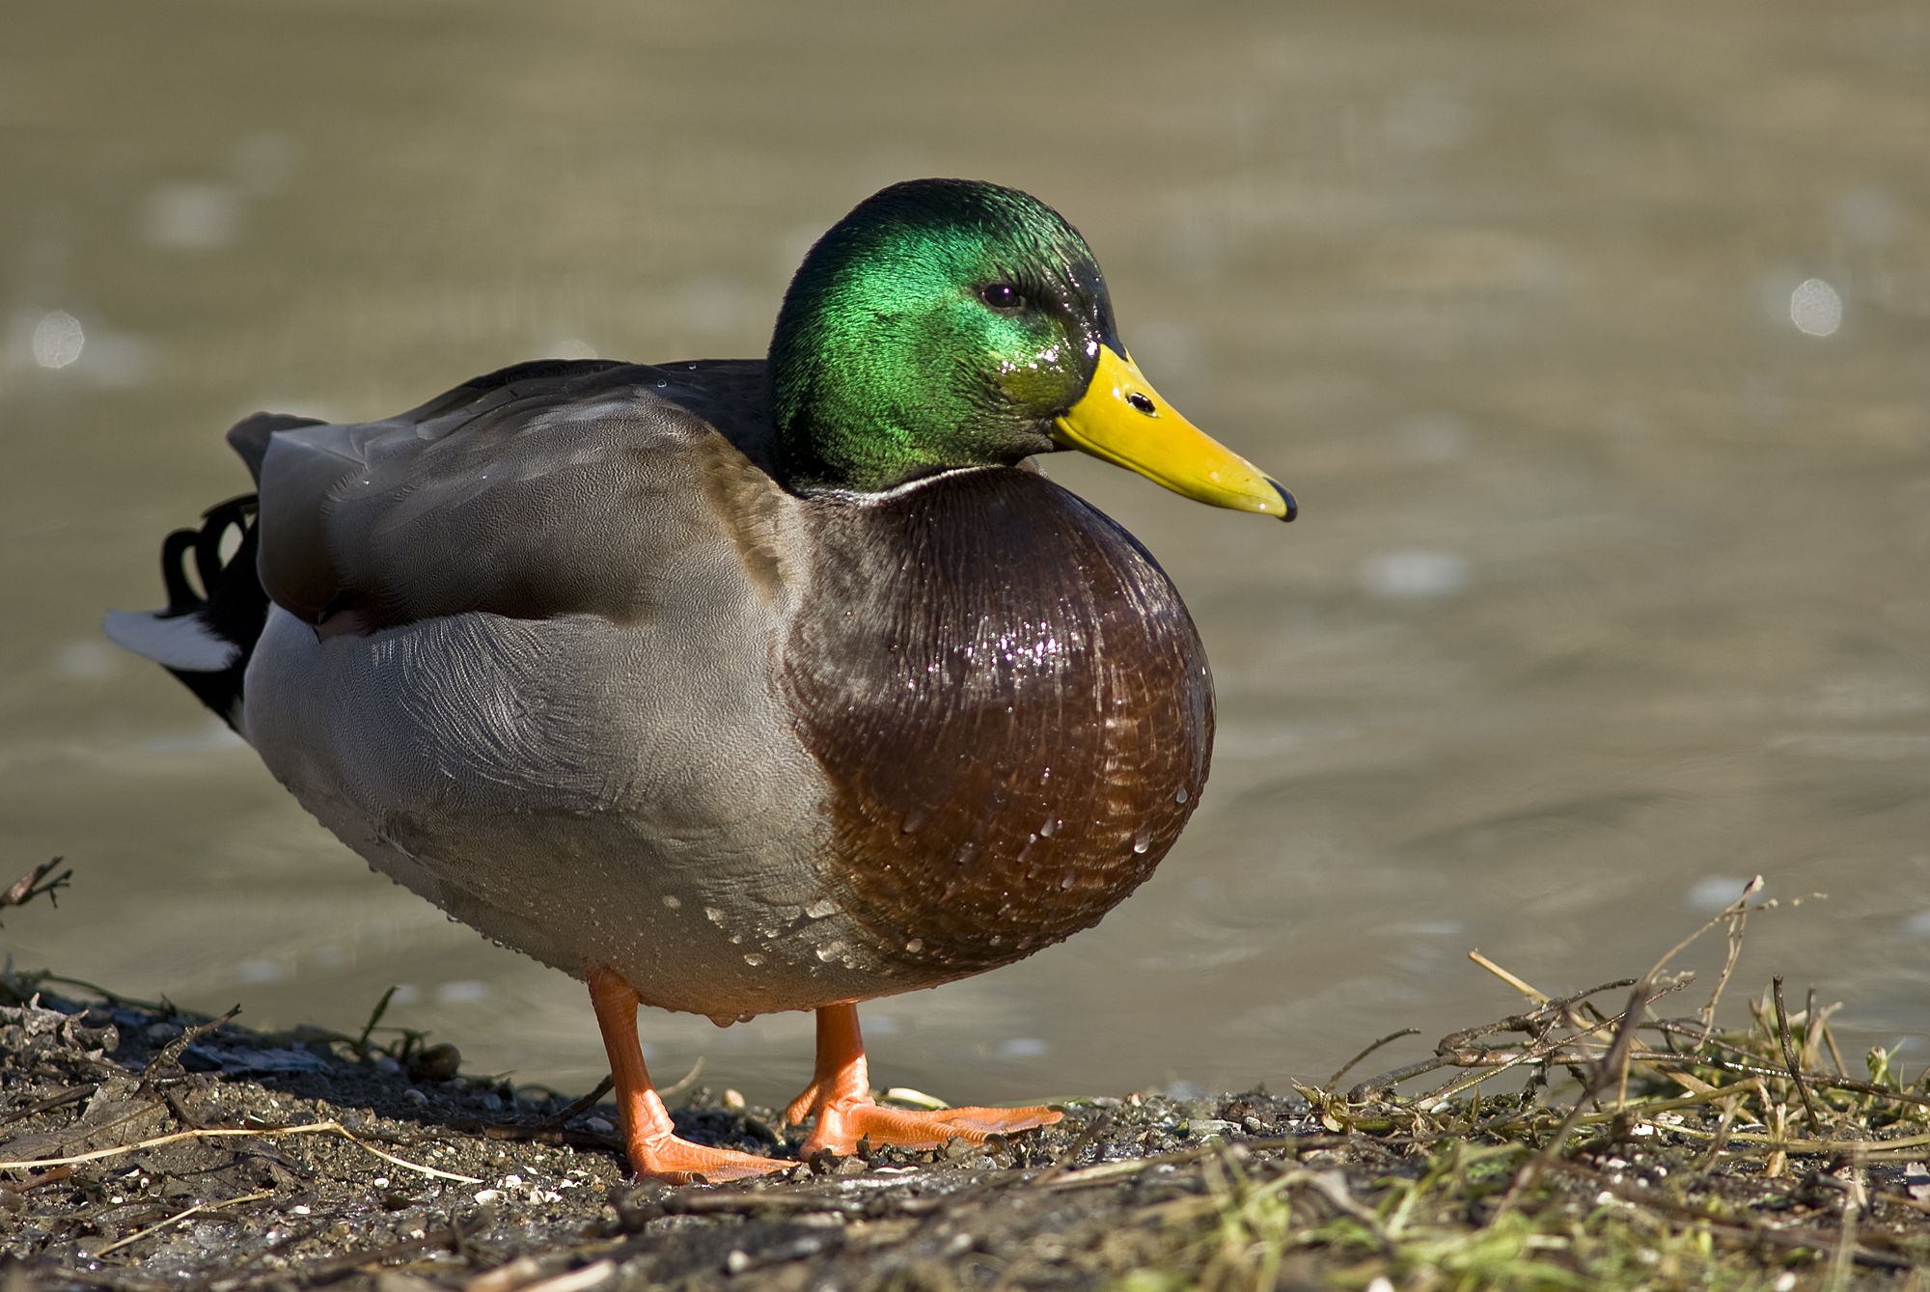
This Photo by Unknown Author is licensed under CC BY-SA
Reliable
Unreliable
Notes:
https://www.nationalgeographic.com/animals/birds/m/mallard/

Slide 33
Correct
This is a reliable source because it follows the CRAPP model.
Question 2

Slide 34
Incorrect
Remember to use the CRAPP model to gauge the reliability of sources.
This source would be considered reliable because of the host website’s credentials.
Question 2

Slide 35
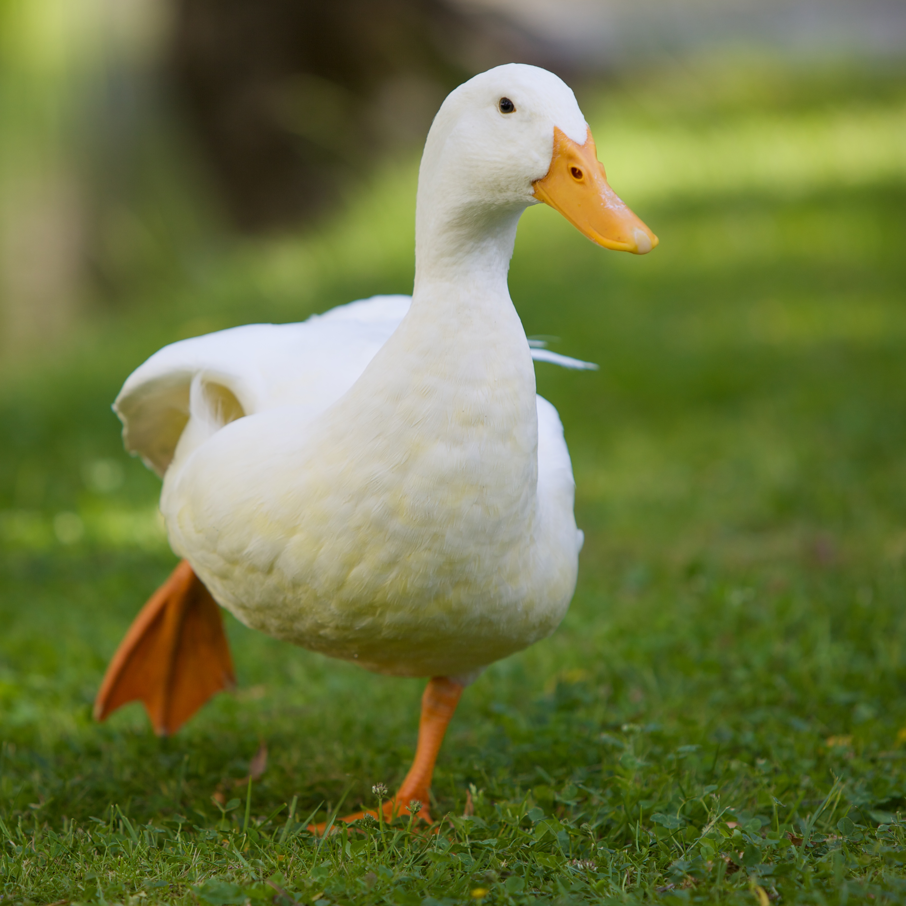
This Photo by Unknown Author is licensed under CC BY-SA
Reliable
Unreliable
Notes:
https://www.allaboutbirds.org/guide/Mallard/lifehistory

Slide 36
Correct
This is a reliable source because it backs its information up with evidence and sources it.
Question 3

Slide 37
Incorrect
This is a reliable source because it uses evidence to back up its information and has sources to back it up.
Question 3

Slide 38
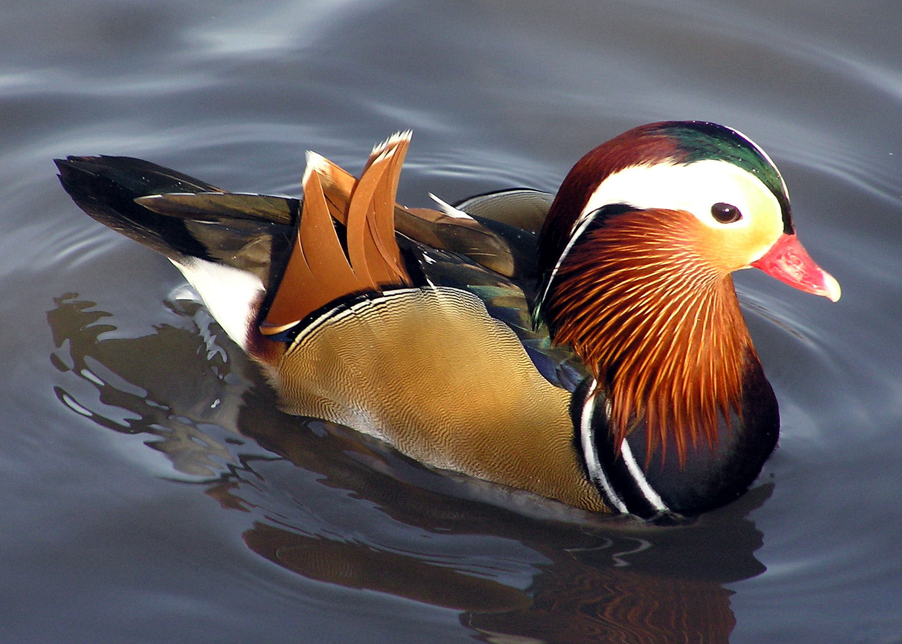
This Photo by Unknown Author is licensed under CC BY-SA
Reliable
Unreliable
Notes:
https://twitter.com/birdsarentreal?lang=en

Slide 39
Correct
This is an unreliable source because it is not cited, backed up with evidence, and has no authority in the author or sponsor.
Final Questions

Slide 40
Incorrect
This is an unreliable source because it is not cited, backed up with evidence, and has no authority in the author or sponsor.
Final Questions

Slide 41
Final Questions
Why is it important to be well informed citizens both in and out of the classroom?
How do we educate others on how to be better Digital Citizens through media literacy?
Should schools be required to teach media literacy?
What have you learned and taken away from this lesson?

